Slide 1
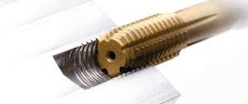
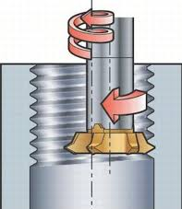
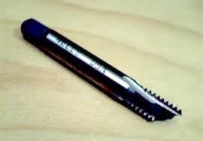
P15
TPM CIRCLE NO :- 02
ACTIVITY
KK
QM
PM
JH
SHE
OT
DM
E&T
KAIZEN IDEA SHEET
TPM CIRCLE NAME:
LOSS NO. / STEP
DEPT :-
RESULT AREA
P
Q
A
C
D
S
M
CELL:-
CELL NAME:- Bracket SPM
MACHINE / STAGE :- A247 Bracket
OPERATION :- Tapping
KAIZEN THEME : To eliminate tap breakages in power failure
IDEA : To have mechanism to reverse the tap
Problem present status :- Frequent tap breakages in case of power failures. 198 numbers in April 16
COUNTERMEASURE:-
PLC logic modification to have in feed retraction of tap with anticlockwise rotation once the power has been resumed
BENCHMARK
198 / month
TARGET
0
KAIZEN START
13.05.2016
KAIZEN FINISH
30.05.2016
TEAM MEMBERS :
D Y Pawar
Sachin Chaudhary
Tap Trapped
BENEFITS :-
Production increased by 4242 no /
month
2) Tap cost saved
Or thread damage
After
KAIZEN SUSTENANCE
Either break
Before
WHY - WHY ANALYSIS :-
RESULT :-
WHAT TO DO:-. Irreversible Kaizen.
HOW TO DO:-
FREQUENCY :-
Why 1 – Tap breakages in power failure Why2 – Jerk on tap Why 3 – Tap gets trapped in the part as cycle interrupted at the time of power failures. Why 4 – No mechanism to reverse the tool when power resumes
After action implementation
ROOT CAUSE : No mechanism to reverse the tool
REGISTRATION NO. & DATE :
Tap breakage phenomena eliminated
Availability of machine increased by
1400 min / month
REGISTERED BY :- Prakash & Sujit
MANAGER’S SIGN :- SNC

